Slide 1
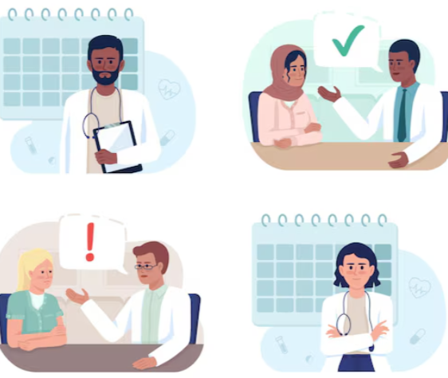
TapToCure

Slide 2

Team Members
Venkatesh A Betageri
Abdul Khuddus Taha
Karanam Sumanth

Slide 3

Overview
▪ Introduction
▪ Problem Statement
▪ Solutions
▪ Technologies Used
▪ Architecture
▪ Future Enhancements

Slide 4

Introduction
TapToCure is a digital healthcare platform that bridges the gap between patients and doctors, enabling convenient and efficient healthcare access.
Connects patients with qualified doctors based on location and specialty.
Enables quick and reliable appointment scheduling.
Provides doctors tools to manage availability and schedules.
Allows patients and doctors to track upcoming and past visits for continuous care.

Slide 5
Problem Statement
Many people struggle to prioritize regular health check-ups, which are essential for staying healthy and preventing illness.
Our busy lives make it difficult to find time for these check-ups.
The process of scheduling appointments can feel complicated and time-consuming.

Slide 6
Solutions
• Efficient Scheduling
• Doctor Search & Filter
• Automated Email Notifications
• Centralized Dashboard

Slide 7
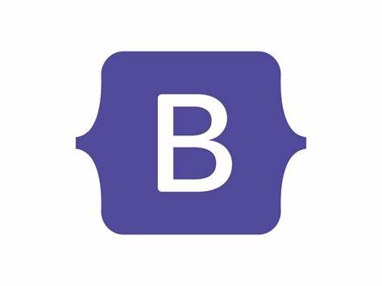
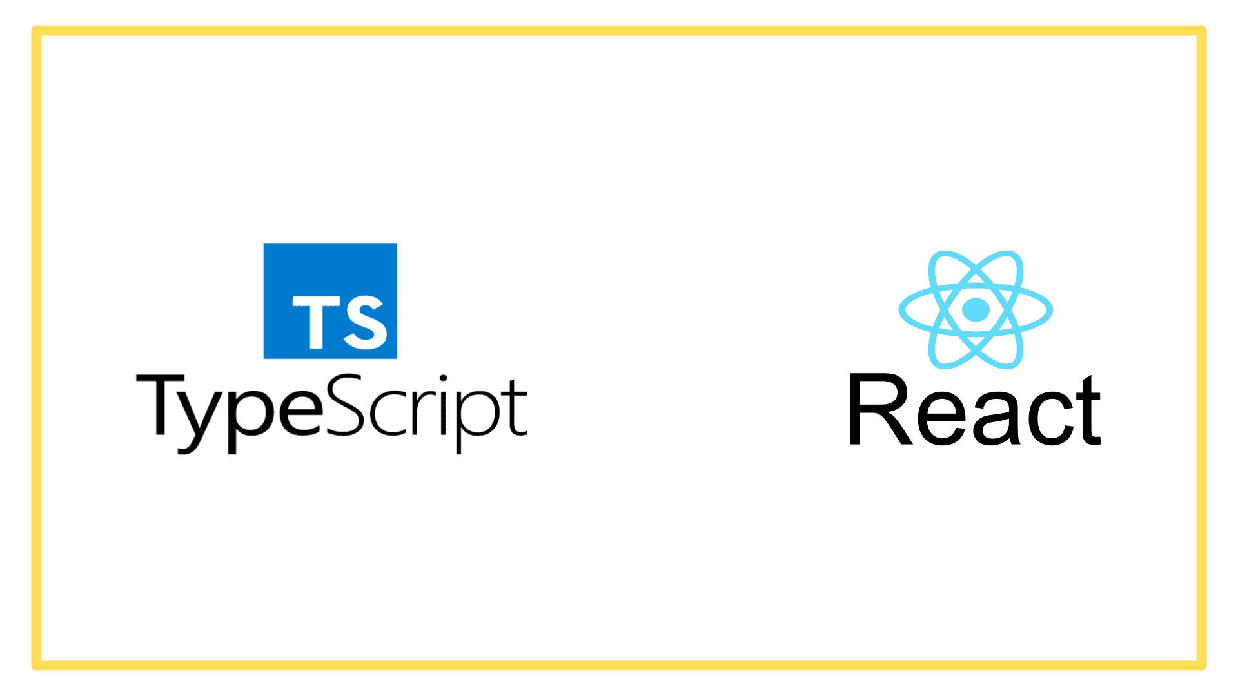

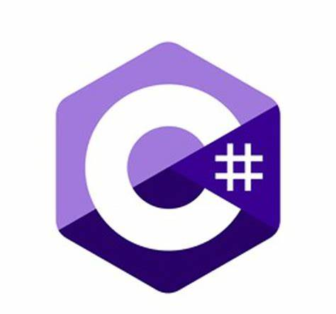




Technologies Used
Frontend
Backend
DataBase

Slide 8


Architecture
Account-Service
Doctor-Service
SQL Server
Patient-Service
Appointment-Service
API Gateway
Slot-Service
Feedback-Service
Mongo DB

Slide 9
Data Flow Diagram
Register
Login
View
Patient
Admin
Doctor
Specialities
Doctors
Appointments
Browse Doctors
Approve/Reject Doctor
Manage Sessions
Book Appointment
View Doctors
Accept Appointments
Give Feedback
View Patients
Provide Prescription

Slide 10

TapToCure
Application Demo

Slide 11
Future Enhancements
• Payment Integration
• Appointment Rescheduling
• Teleconsultancy Implementation

Slide 12

THANK YOU

